Slide 1


Urban Emission Hotspot Mapping – Hyderabad
Data-Driven Climate Action for Targeted Urban Sustainability
6 Priority Zones Identified. 10–25% CO₂ Reduction Potential.
Team AGNI
Kuchipudi Yokshith - 1M1BGI060098
Dasu Swapnika - 1M1BGI060088
K Geetha Uma Maheswari - 1M1BGI060133
Revanth Kumar Merugu - 1M1BGI060124
Notes:
1

Slide 2
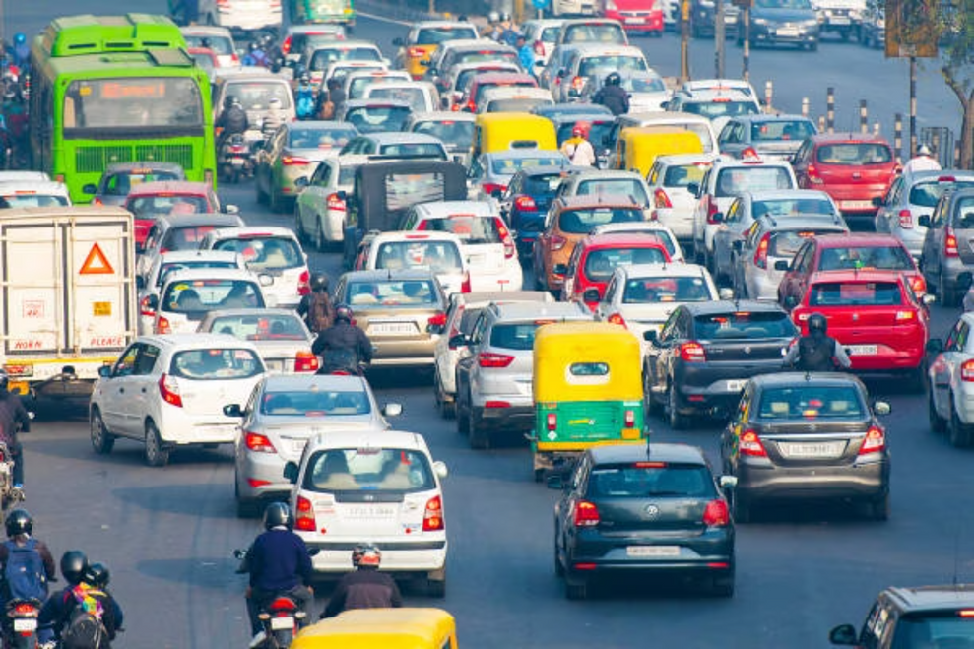
Hyderabad's Air Pollution Challenge
The Hidden Problem
Hyderabad's Air Quality Index exceeds 150 (Unhealthy) for 25–30% of winter days. But city-level averages mask a critical reality: pollution concentrations vary dramatically across neighborhoods.
Areas like Adikmet, Ameerpet, and Begumpet experience significantly worse conditions than the city average. Yet Greater Hyderabad Municipal Corporation (GHMC) policies focus primarily on city-wide measures, missing opportunities for targeted intervention where impact would be greatest.
The Opportunity: By mapping exactly where pollution concentrates, we can direct resources to areas that matter most—achieving faster, more cost-effective results than blanket approaches.
Notes:
2

Slide 3
Our Methodology
We developed a Grid-Based Emission Index combining traffic intensity and industrial influence to identify pollution hotspots with precision.
01
02
03
Grid Division
Traffic & Industrial Scoring
Emission Index Calculation
Divided GHMC into 600+ uniform cells (1 km × 1 km). Each cell receives a unique identifier for systematic tracking and analysis across the entire metropolitan area.
Calculated Traffic Score based on proximity to MMTS (Metro & Bus) stops as congestion proxy. Determined Industrial Score using distance to major zones (Hadapsar, Jeedimetla, Miyapur). Both normalized to 0–1 scale.
Combined scores using formula: Emission Index = 0.5 × Traffic Score + 0.5 × Industrial Score. Equal weighting acknowledges both sources as major contributors to urban pollution.
04
05
Interactive Visualization
Hotspot Identification
Created Folium heatmap showing all cells with color-coded risk levels. Built comprehensive Tableau dashboard with bar, scatter, and line chart views. Published with #1M1B hashtag for public access.
Ranked all cells by Emission Index. Identified top 6 priority zones using reverse geocoding. Developed targeted, sector-specific mitigation strategies for each hotspot type.
Notes:
3

Slide 4

Six Priority Zones Identified
Our analysis identified six critical hotspots where targeted intervention could achieve 10–25% CO₂ reduction—far exceeding the impact of city-wide uniform policies.
Rank
Area
Emission Index
Hotspot Type
1
Adikmet
0.81
Mixed (Traffic + Industrial)
2
R.K. Nagar–Malkajgiri
0.80
Traffic-Dominated
3
Begumpet–HPS / Sardar Patel Rd
0.72
Traffic-Dominated
4
Ameerpet Corridor
0.70–0.72
Mixed (Transport Hub)
5
Somajiguda–Necklace Rd
0.68
Mixed (Tourism + Congestion)
6
Gayatri Nagar–Lingampally–Rail Vihar
0.67
Traffic-Dominated
Key Insight: These six zones concentrate disproportionate emission potential. A targeted 10–20% reduction in these areas would significantly improve city-wide air quality while using 3–5x fewer resources than blanket policies.
Notes:
4

Slide 5


Interactive Data Visualization Tools
Folium Heatmap
Tableau Dashboard
Interactive choropleth map visualizes all 600+ grid cells with color gradient from yellow (low risk) through orange to red (high risk). Clickable pop-ups reveal Cell ID, Traffic Score, Industrial Score, Emission Index, and Area Name.
Three Integrated Views:
Bar Chart: Ranks top hotspot areas by Emission Index, showing Adikmet (0.81) and R.K. Nagar (0.80) as clear priorities with sharp drop after top three
Built on OpenStreetMap base with GHMC boundary overlay and optional MMTS stop markers for geographic context.
Scatter Plot: Visualizes Traffic vs. Industrial drivers with color-coded Emission Index, revealing critical high-high quadrant mixed hotspots
Line Chart: Displays temporal AQI trends validating persistent elevation above safe limits throughout the year
Published to Tableau Public with #1M1B hashtag, enabling GHMC planners to explore any neighborhood's emission profile in seconds and share findings with community stakeholders.
Notes:
5

Slide 6



Three Hotspot Types, Three Strategies
Traffic-Dominated
Industrial-Dominated
Mixed (HIGHEST PRIORITY)
Examples: Begumpet–HPS, Lingampally, Gayatri Nagar
Examples: Hadapsar, Jeedimetla, Miyapur estates
Examples: Adikmet, R.K. Nagar, Ameerpet, Somajiguda
Characteristics: High congestion, heavy vehicle density, major transit corridors with limited industrial influence
Characteristics: Manufacturing zones with stack emissions, fugitive process emissions, limited transit access
Characteristics: Both high traffic AND industrial influence, dense mixed land use, overlapping emission sources
Solutions: EV/Bus-only corridors, Metro extensions, AI traffic optimization, congestion pricing
Solutions: Stricter emission norms, fuel switching to natural gas/renewables, ISO 50001 certification, green buffer zones
Solutions: Integrated transport + industrial plans, multi-modal TOD nodes, e-commerce fleet electrification, community campaigns
Impact: 15–20% road-transport CO₂ reduction over 3–5 years
Impact: 10–15% industrial PM2.5 & NOx reduction
Impact: 20–25% combined reduction (HIGHEST ROI)
Different hotspot types require different interventions. This targeted approach delivers 3–5x greater efficiency than city-wide one-size-fits-all policies.
Notes:
6

Slide 7



Concrete Mitigation Actions by Zone Type
Traffic Hotspots
Industrial Hotspots
Mixed Hotspots (Priority)
Begumpet, Lingampally, Gayatri Nagar
Hadapsar, Jeedimetla
Adikmet, R.K. Nagar, Ameerpet, Somajiguda
EV/Bus-Only Corridors: Designate 2–3 key routes with charging infrastructure at transit nodes (6–12 months)
Stricter Emission Norms: Quarterly SPCB audits with stack monitoring and penalties for non-compliance
Integrated Planning: Coordinate GHMC transport with SPCB for 15–20% transport + 10% industrial co-benefits
Metro Extension: Prioritize connectivity for areas 2–5 km from existing stations (2–4 years)
Fuel Switching: Natural gas subsidies for boilers, solar thermal incentives reducing PM2.5 & NOx 20–30%
Multi-Modal TOD: Transit hubs mixing residential, commercial, green space reducing commute distance 30–40%
AI Traffic Signals: Deploy real-time optimization reducing idling emissions 10–15% (3–6 months pilot)
Energy Efficiency: ISO 50001 certification incentives with free energy audits (1–2 years adoption)
Fleet Electrification: Incentivize delivery companies for logistics hub conversion (1–2 years)
Congestion Pricing: Dynamic peak-hour pricing with revenue funding transit subsidies (6–12 months)
Green Buffers: Mandated tree planting around perimeters as natural PM2.5 filters (2–3 years to mature)
Community Campaigns: Public health messaging encouraging carpooling and transit adoption
These proven solutions—deployed successfully in Delhi, Bangalore, Copenhagen, and Shanghai—require implementation focus on hotspots first for maximum impact.
Notes:
7

Slide 8



Quantified Climate & Social Impact
Climate Metrics
6
10-25%
600+
800+
Hotspot Clusters
CO₂ Reduction Potential
Grid Cells Mapped
AQI Records Analyzed
High-priority zones with Emission Index ≥ 0.68, clearly named with geographical precision enabling targeted action
Achievable through hotspot-specific measures—2–3x faster than city-wide policies
Neighborhood-level granularity vs. 3–5 city-level AQ stations—each cell scored for traffic, industrial impact, and emission index
Time-series validation showing hotspot areas experience 20–30% higher pollution than city average
This project created measurable climate impact (6 zones, 10–25% reduction potential) while building social capital through stakeholder engagement, community science, and equitable geographic focus.
Notes:
8

Slide 9

Social Metrics
5+ Stakeholders Engaged
Public Dashboard Published
Faculty mentor, peers, local residents (Ameerpet, Adikmet validating ground conditions), environmental NGOs (ICLEI, Ceres), and expected GHMC planners
Live Tableau Public dashboard with #1M1B hashtag—200–500 expected views via LinkedIn and shared links, accessible to anyone for exploration
Citizen Science Roadmap
Equitable Focus
Plan for 2–3 low-cost PM2.5 sensors in Adikmet and Ameerpet enabling community-led monitoring and local ownership
High-exposure neighborhoods explicitly named and mapped, ensuring policy action benefits marginalized areas directly
Notes:
9

Slide 10
Skills Developed Through This Internship
Green Skills 🌱
Data Skills 💻
Professional Skills 🎯
Spatial Thinking: Neighborhood-level analysis proves far more powerful than city averages. The 80/20 concentration rule applies to emissions—6 zones create disproportionate impact.
GeoPandas & Spatial Operations: Grid creation, spatial joins for distance calculations, choropleth mapping for visualization across GHMC boundary.
Project Scoping: Broke down complex urban emissions problem into actionable steps with realistic objectives and timelines, prioritizing high-impact deliverables.
Multi-Source Integration: Combined 3+ datasets (MMTS, industrial zones, AQ, boundaries) handling different formats and projections with reverse geocoding.
Emissions Science: Traffic and industrial sources dominate urban PM2.5 in growing cities. Targeted measures achieve 3–5x greater cost-effectiveness than broad policies.
Stakeholder Communication: Explained technical concepts (Emission Index) in accessible language, incorporated diverse feedback, tailored presentations for different audiences.
Tableau Proficiency: Built multi-view dashboards with conditional coloring, published to Tableau Public for widespread access.
Urban Planning Context: Transit-oriented development reduces emissions by design. Community engagement builds essential buy-in for climate action success.
Visual Storytelling: Used heatmaps, dashboards, and tables to transform data into compelling narrative—Problem → Approach → Findings → Recommendations.
Jupyter Workflow: Developed reusable, documented code with iterative testing and clean dataset exports.
Iterative Development: Built incrementally, tested early with mentors, refined based on continuous feedback.
Key Insight: Even a student-level project with open data can create a powerful decision-support tool for cities. These three skill dimensions—green, data, and professional—reinforce each other to drive meaningful impact.
Notes:
10

Slide 11
Future Roadmap: From Data to Action
Phase 1: Validation & Stakeholder Presentations (Jan 2026)
1
Present findings to GHMC planning and transport departments. Refine hotspot rankings with official data. Publish summary article on LinkedIn/Medium with #1M1B #Hyderabad hashtags.
2
Phase 2: Community Pilot & Ground Truth (Feb–Mar 2026)
Expected Outcome: GHMC interest in integrating hotspot map into 2026 climate plan
Deploy 2–3 low-cost PM2.5 sensors in Adikmet and Ameerpet. Conduct 10–15 resident interviews on transport choices, air quality perception, and receptiveness to sustainable options. Validate model predictions against sensor data.
Phase 3: Model Refinement & ML Development (Apr–Jun 2026)
3
Expected Outcome: Refined model with community buy-in stories
Integrate real traffic data (Google Maps API, GHMC road counts). Build ML model predicting hourly AQI from traffic and industrial scores. Add temporal variation for seasonal and episodic events. Enhance industrial data with official SPCB registry.
4
Phase 4: Replication & Multi-City Comparison (Jul–Dec 2026)
Expected Outcome: More accurate, predictive emission model
Extend framework to Pune and Bangalore using identical methodology. Create comparative analysis across cities. Document replicable "Hotspot Mapping Toolkit" for other Indian cities. Share via academic paper or open-source code.
Phase 5+: Policy & Real-World Advocacy (2027+)
5
Expected Outcome: Proof of concept for national scaling; 1M1B network expansion
Partner with 1M1B network and environmental NGOs (ICLEI, Ceres, WRI) to advocate for hotspot-based climate plans. Support real-world pilot (EV corridor in Adikmet or industrial efficiency in Jeedimetla). Measure achieved AQI/CO₂ reductions. Scale best practices nationally.
Expected Outcome: Measurable real-world impact; policy briefs and academic publications
Notes:
11

Slide 12

Hyderabad's air can be cleaner. With data, focus, and community support, we can do this.
Implement Pilots
Test interventions in neighborhoods
Cleaner Hyderabad
Validate with Community
Data-driven community climate action
Gather feedback and local insights
Scale to Cities
Expand successful models broadly
This isn't the end of the project—it's just the beginning. The next phase is real-world implementation, community validation, and scaling to other cities. Together, we can transform data into lasting climate action.
Notes:
12

Slide 13

Thank You, 1M1B.
For the invaluable opportunity to drive meaningful change and contribute to a cleaner Hyderabad.
Notes:
13

